Slide 1
Produce PLA plastics from lactate
Make plastic from milk

Slide 2
It all began ...

Slide 3
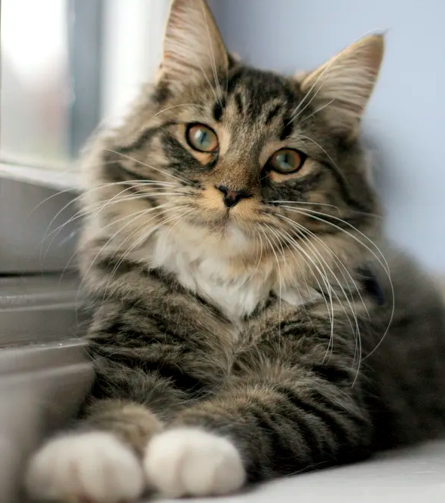
... with a cat!!!
Notes:
ΓΑτισια απροσεξία βαυαρός χημικός Άντολφ Σπίτελερ

Slide 4
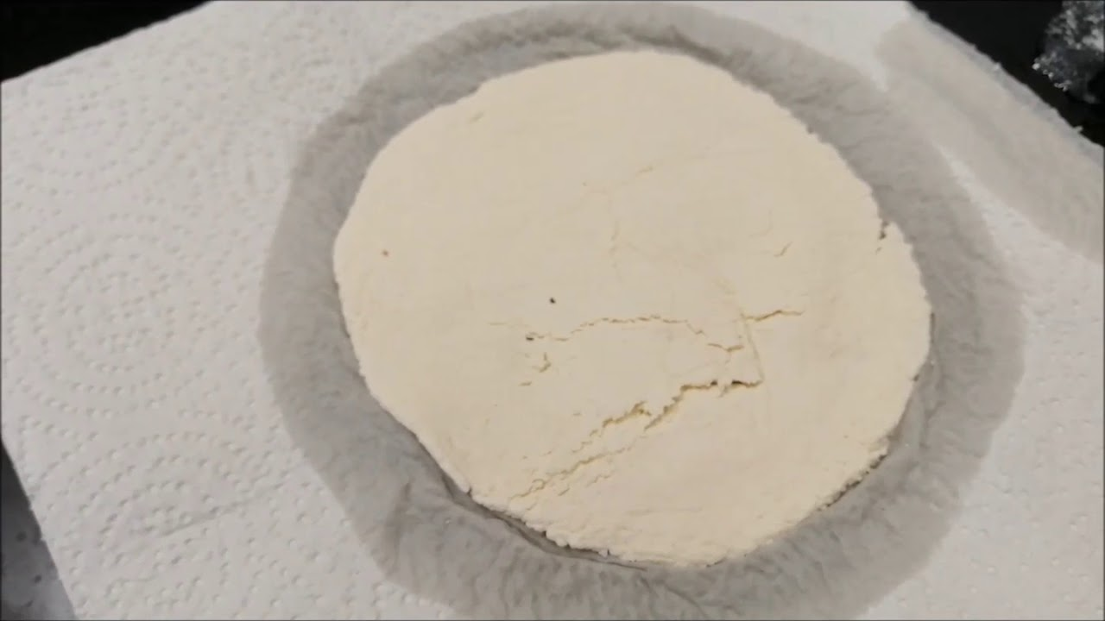
The careless cat, however, threw the bottle and the liquid rolled on the counter and finally fell into the animal's milk.
One night in 1897, Mr. Spitler left a bottle of vinegar on the counter of his laboratory.
The next morning, Mr. Spitler noticed that the milk had solidified into a hard, plastic-like material.

Slide 5
What had happened?
Essentially, vinegar had transformed casein! It had changed its shape to a shape similar to the shape of plastics.
This is what scientists call polymerization.

Slide 6

“
It's time for us to do the same experiment that the cat did to make milk from plastic !!

Slide 7
Material
200ml milk
Kitchen paper
1 tablespoon of vinegar
Greaseproof paper
A strainer
Gloves
Notes:
Υλικά:
0,3lt γάλα
1 κουταλιά λευκό ξύδι
Σουρωτήρι ή ένα λεπτό ύφασμα
Χαρτί κουζίνας
(Αρωμα /αιθεριο ελαιο )
Χρώμα ζαχαροπλαστικής
Φούρνος μικροκυμάτων
Γάντια
Αντικολλητικό χαρτί

Slide 8
Procedure
3.We pour the milk into a strainer or a piece of cloth
4.We add a little food color (optional)
1. We heat the milk until it reaches room temperature
2.We poor in a tablespoon of vinegar and we can see the formation of a white sticky substance (casein)
4.We knead it with our hands to give it a shape or we place it into molds
5.We let it dry

Slide 9
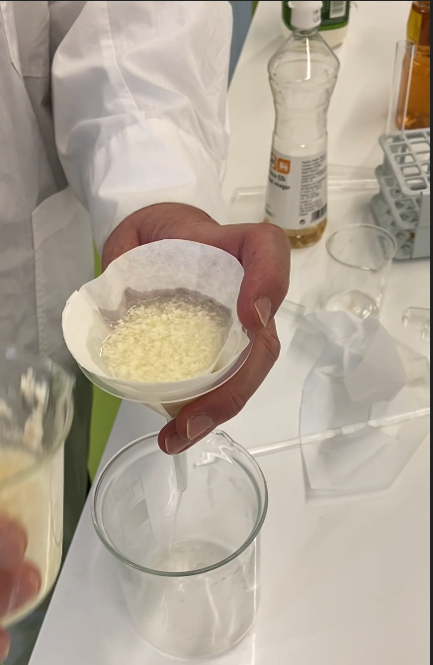
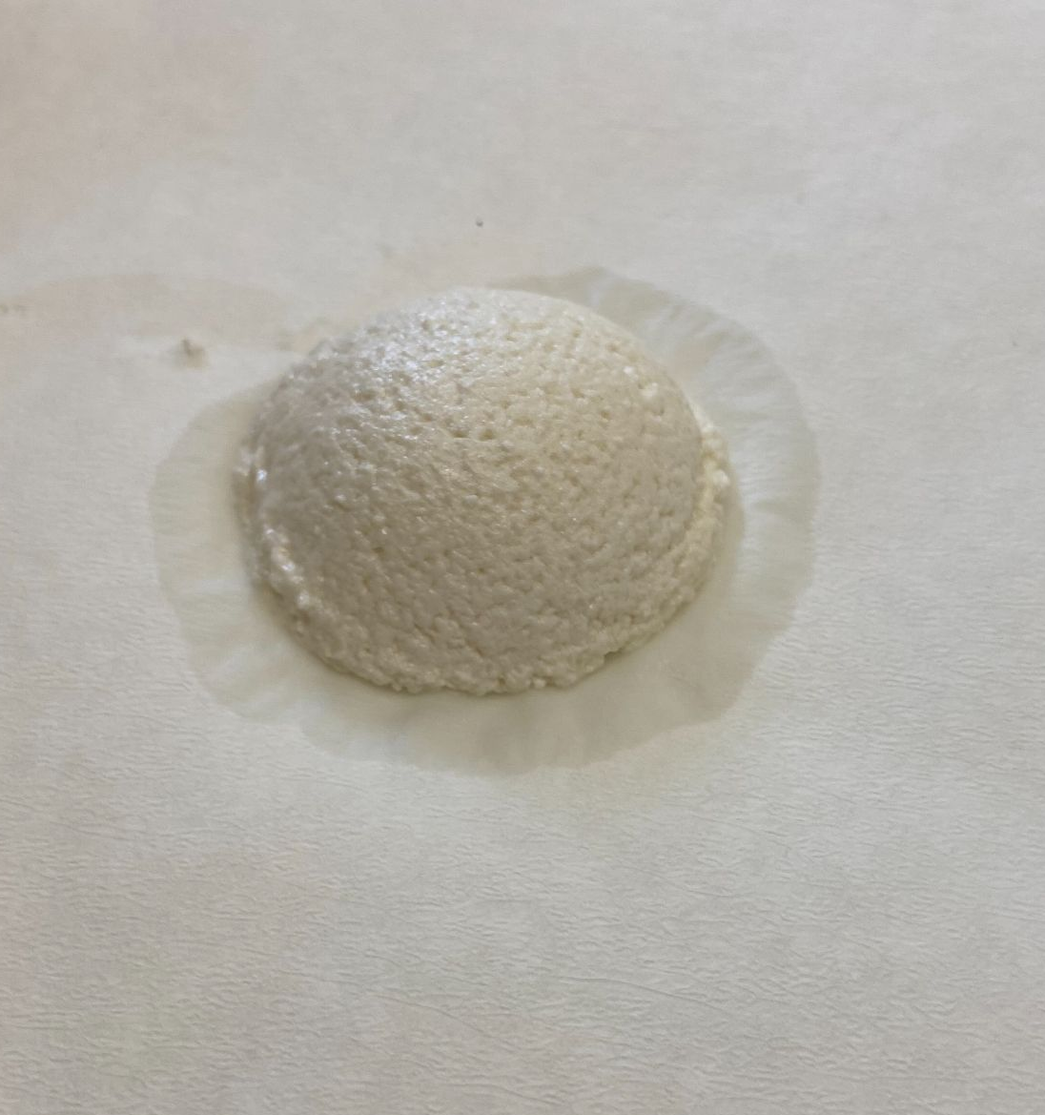

Slide 10
